Slide 1
EXPORTING MODULAR ASSETS TO UNITY

Slide 2
PREPARING MAX SCENE
1) Unity does not support two-sided opacity.
As such, if any polys mapped with opacity are to be viewed from both sides, they must be duplicated in the 3DS Max scene and flipped.
To preserve smoothing groups, do not weld these polys; leave them as elements.
2) Run through all pre-export checks. Ensure pivots are logically positioned.
3) Select all pivot points and orient such that y becomes the vertical axis.

Slide 3
PREPARING TEXTURES
1) Unity uses coloured emission maps. As such, you will need to make a coloured version of the greyscale map used by 3DS Max.
To identify this characteristic, you might want to name the texture with a suffix such as _emic (emission with colour).

Slide 4
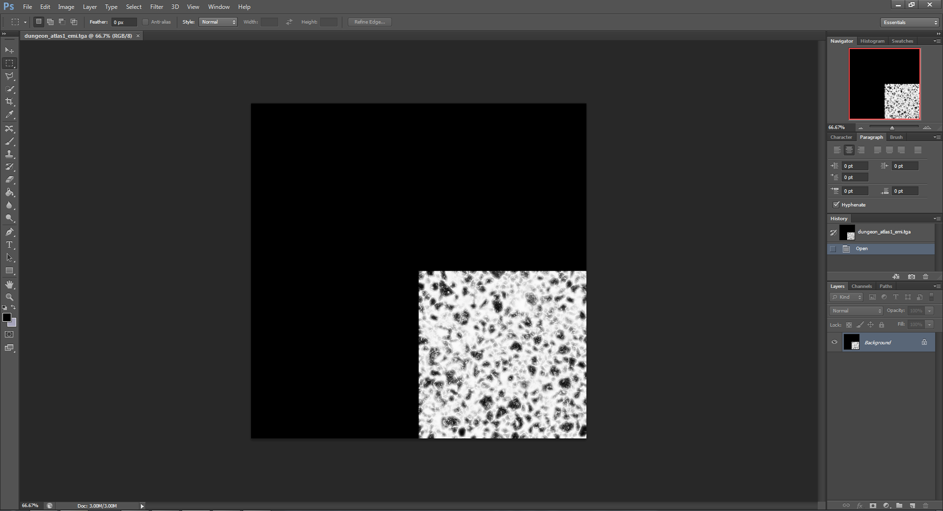
PREPARING TEXTURES
Emission map for 3DS Max (greyscale)

Slide 5
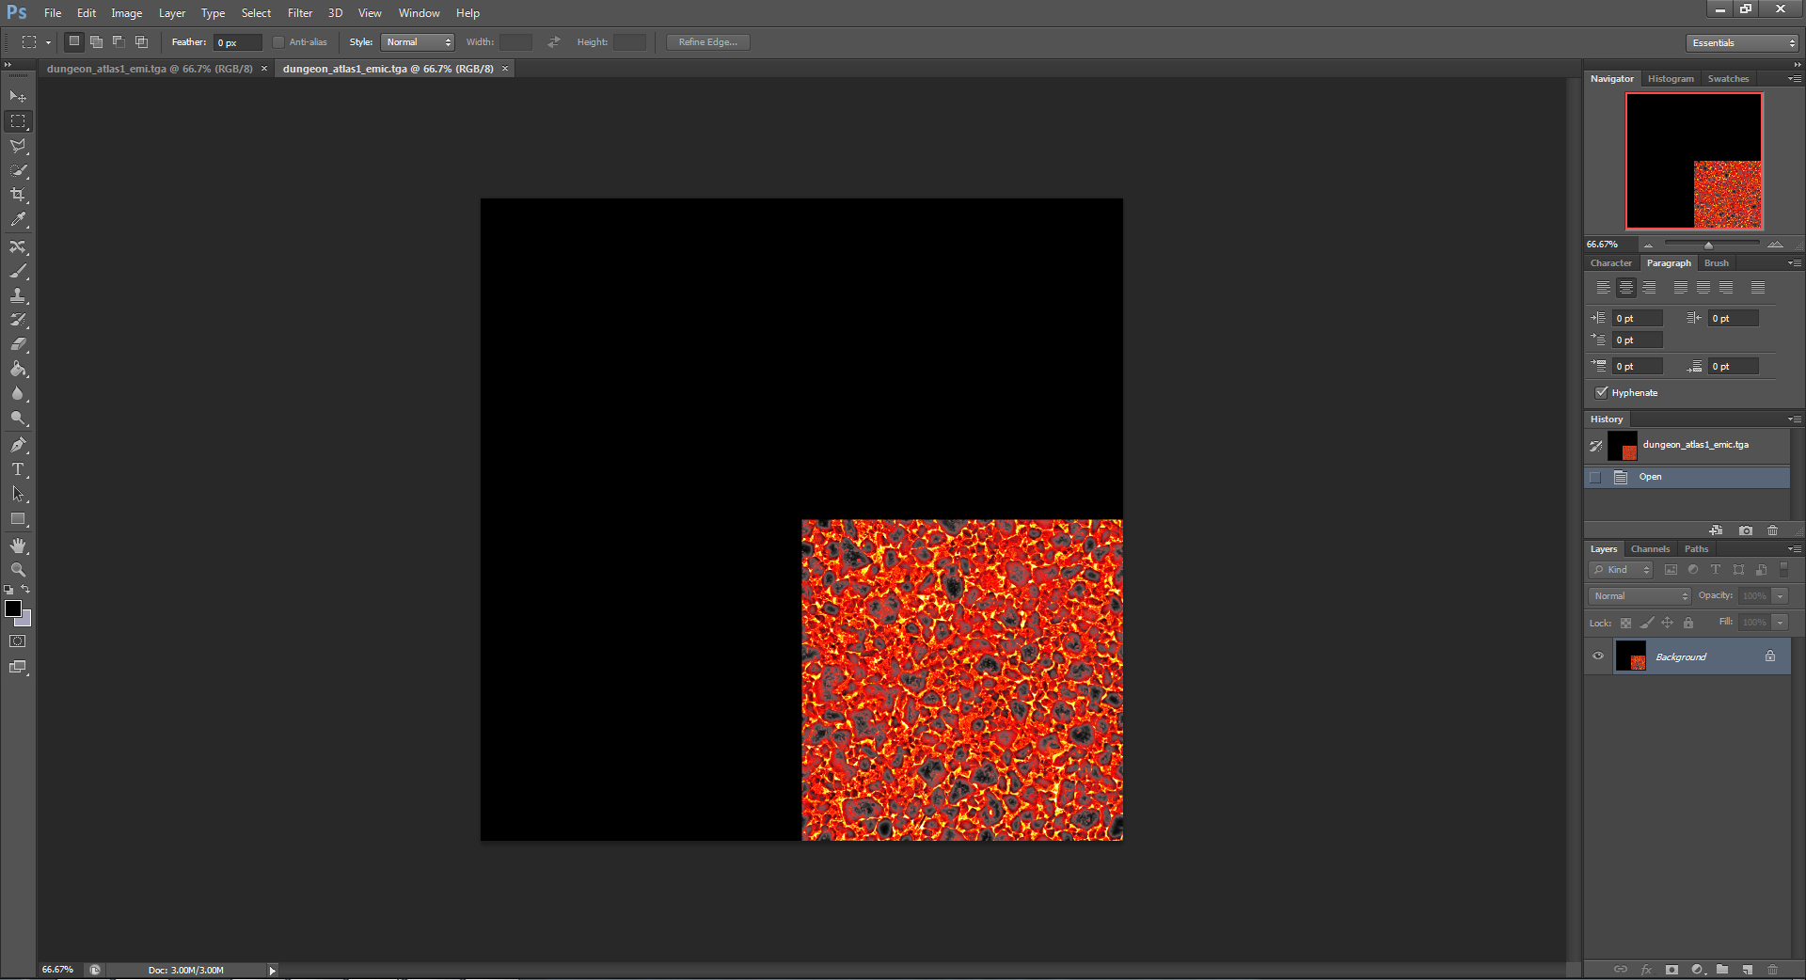
PREPARING TEXTURES
Emission map for Unity (coloured)

Slide 6
PREPARING TEXTURES
2) Unity does not provide a slot for opacity maps. As such, these need to be added to the alpha channel of your diffuse colour map. The diffuse colour map must, therefore, be saved as a 32-bit tga.
Because this colour map now contains opacity information too, you might want to identify this characteristic by using a suffix such as _colopa (colour with opacity).

Slide 7
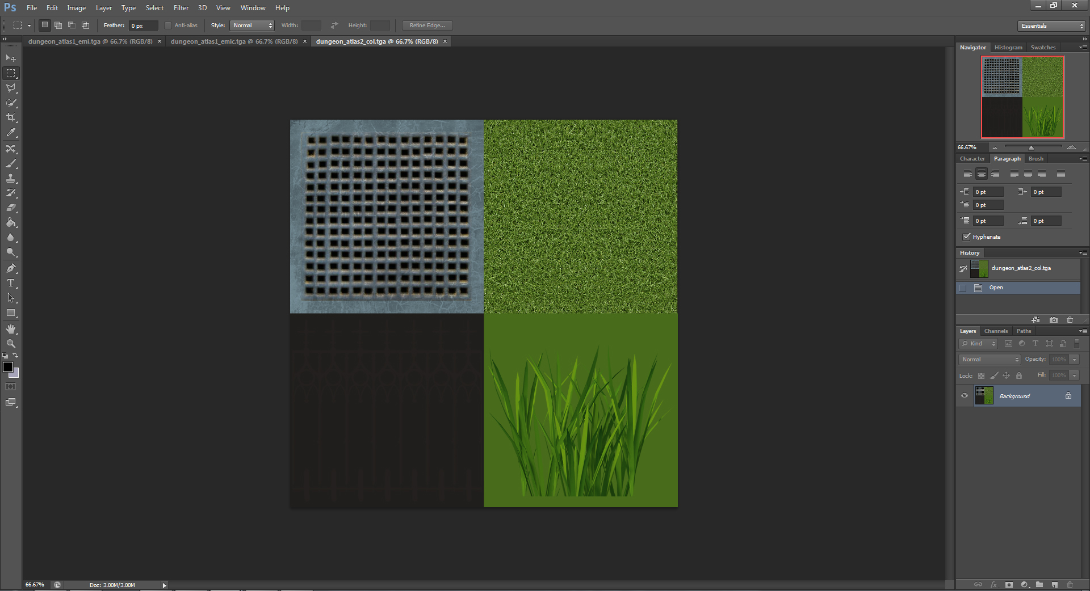
PREPARING TEXTURES
Colour map without opacity

Slide 8
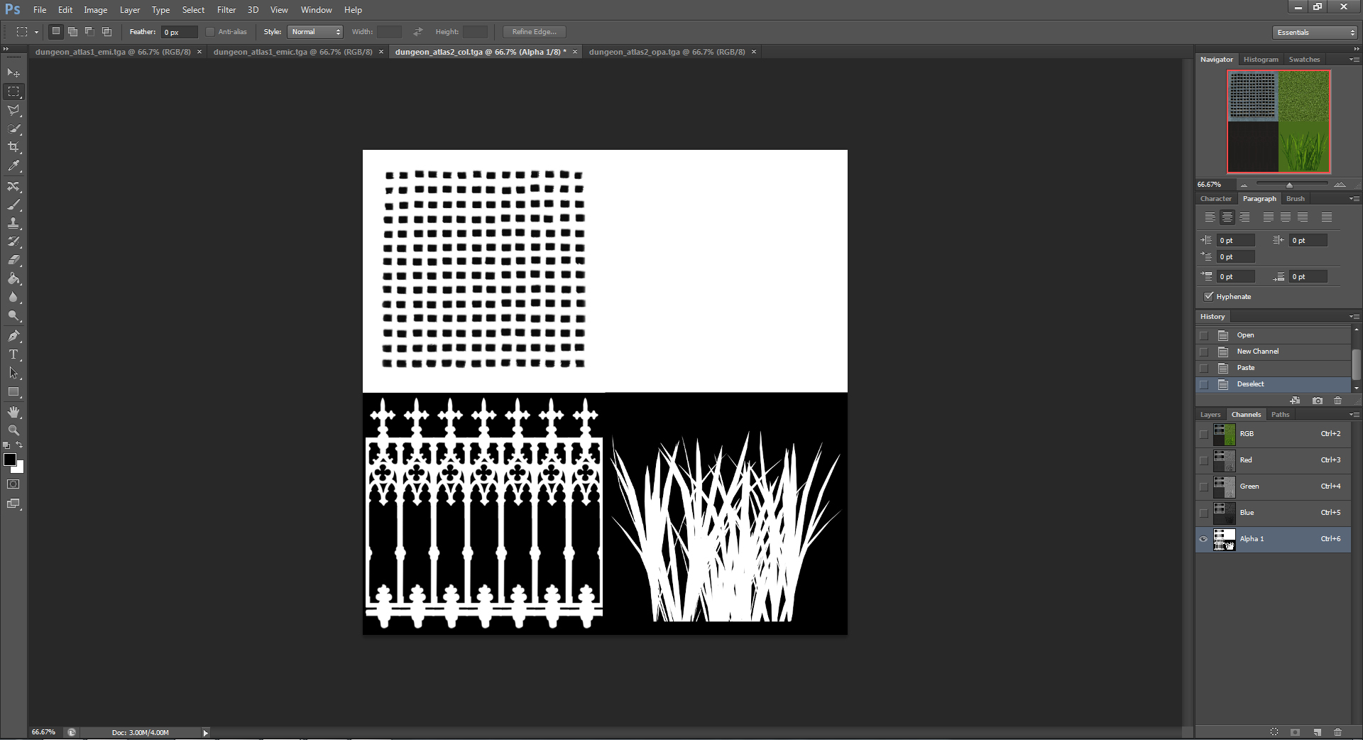
PREPARING TEXTURES
Colour map with opacity added to alpha channel

Slide 9
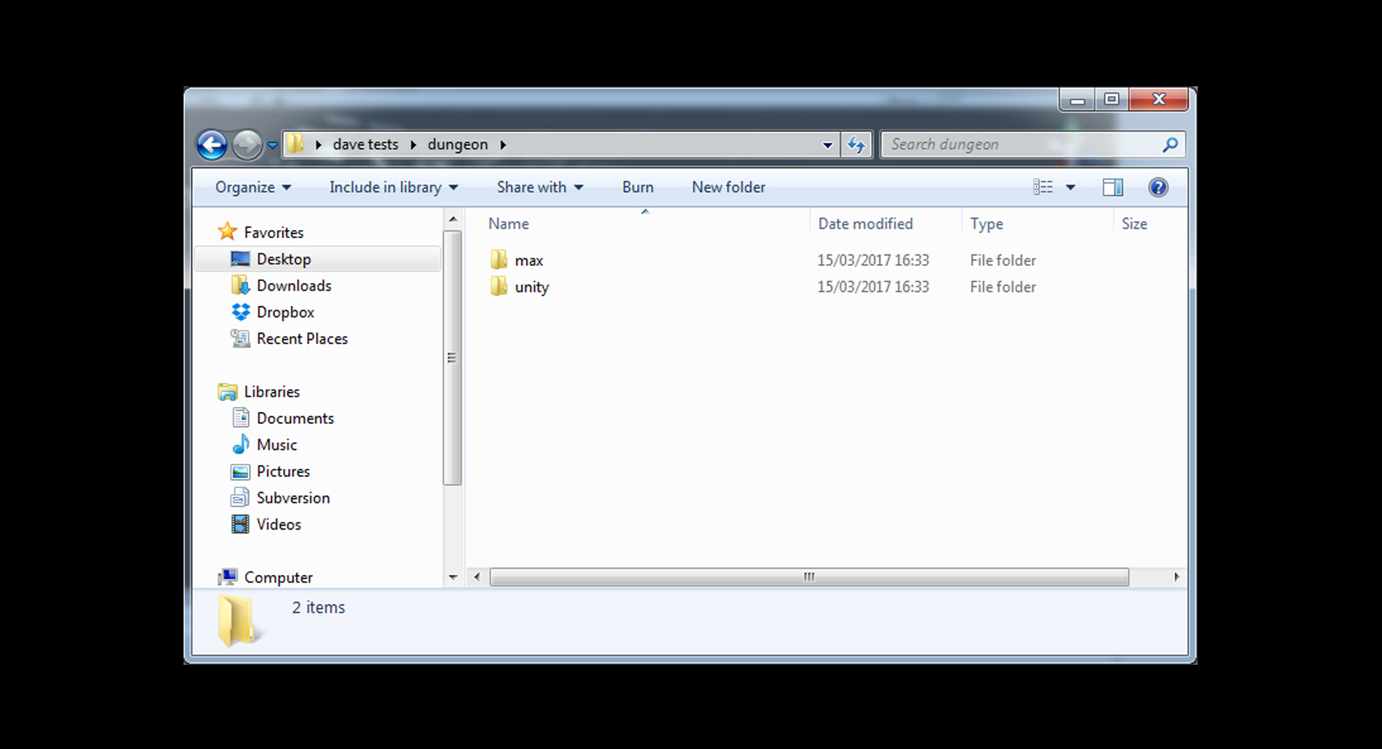
PREPARING TEXTURES
Keep all files safe in separate folders.

Slide 10
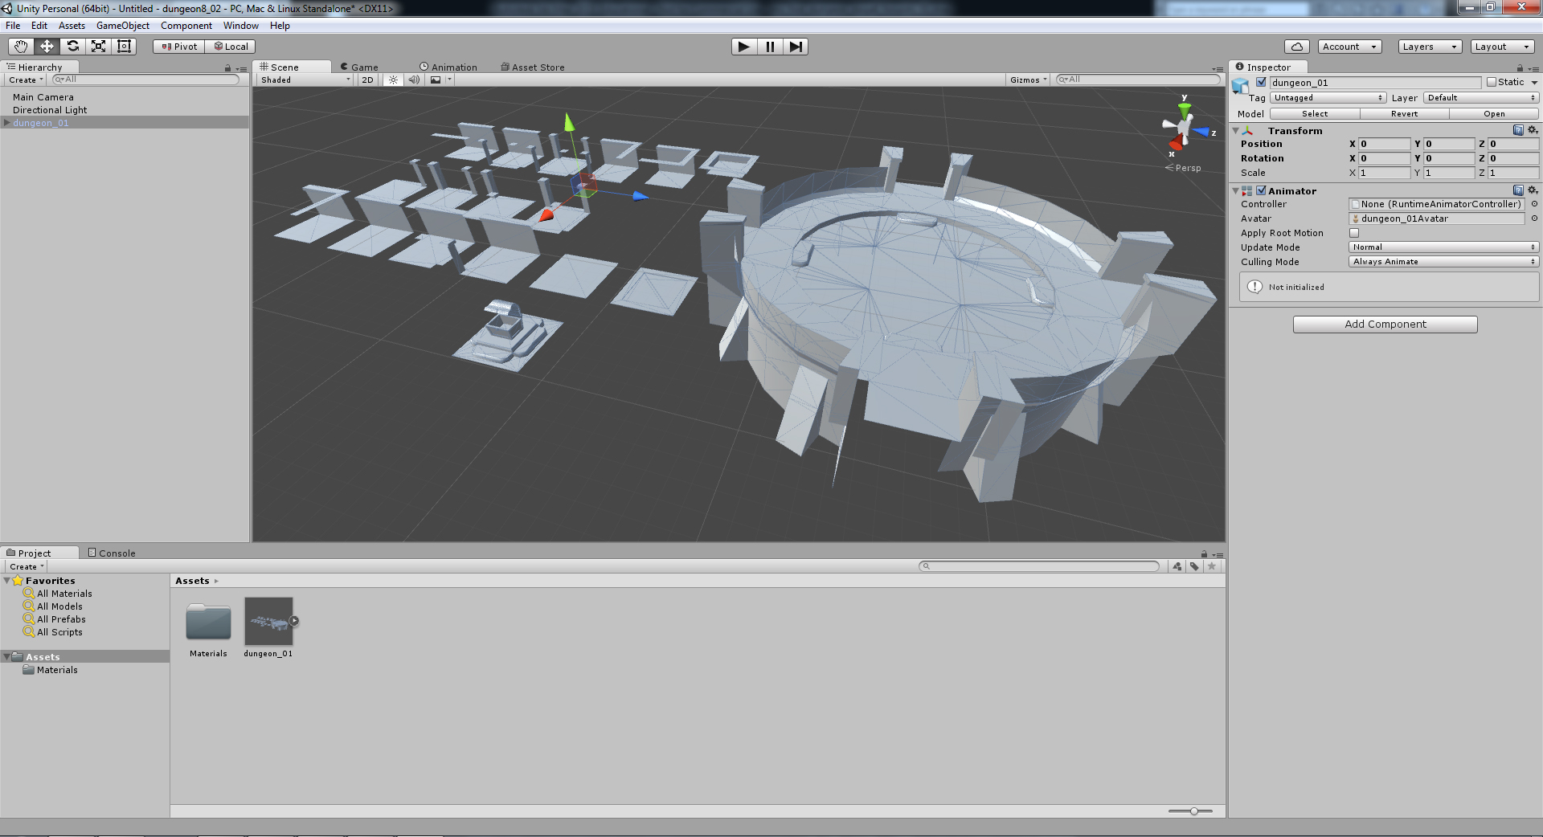
Drag the fbx file into the Unity Project Assets panel and translate to the origin.

Slide 11
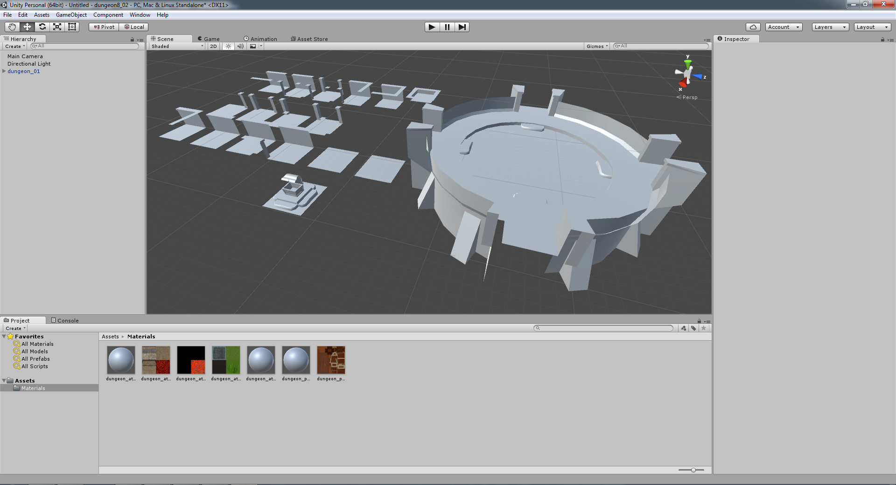
ASSEMBLING MATERIALS
Drag the Unity-ready textures into the Materials folder.
Your naked sub-object materials are in there already.

Slide 12
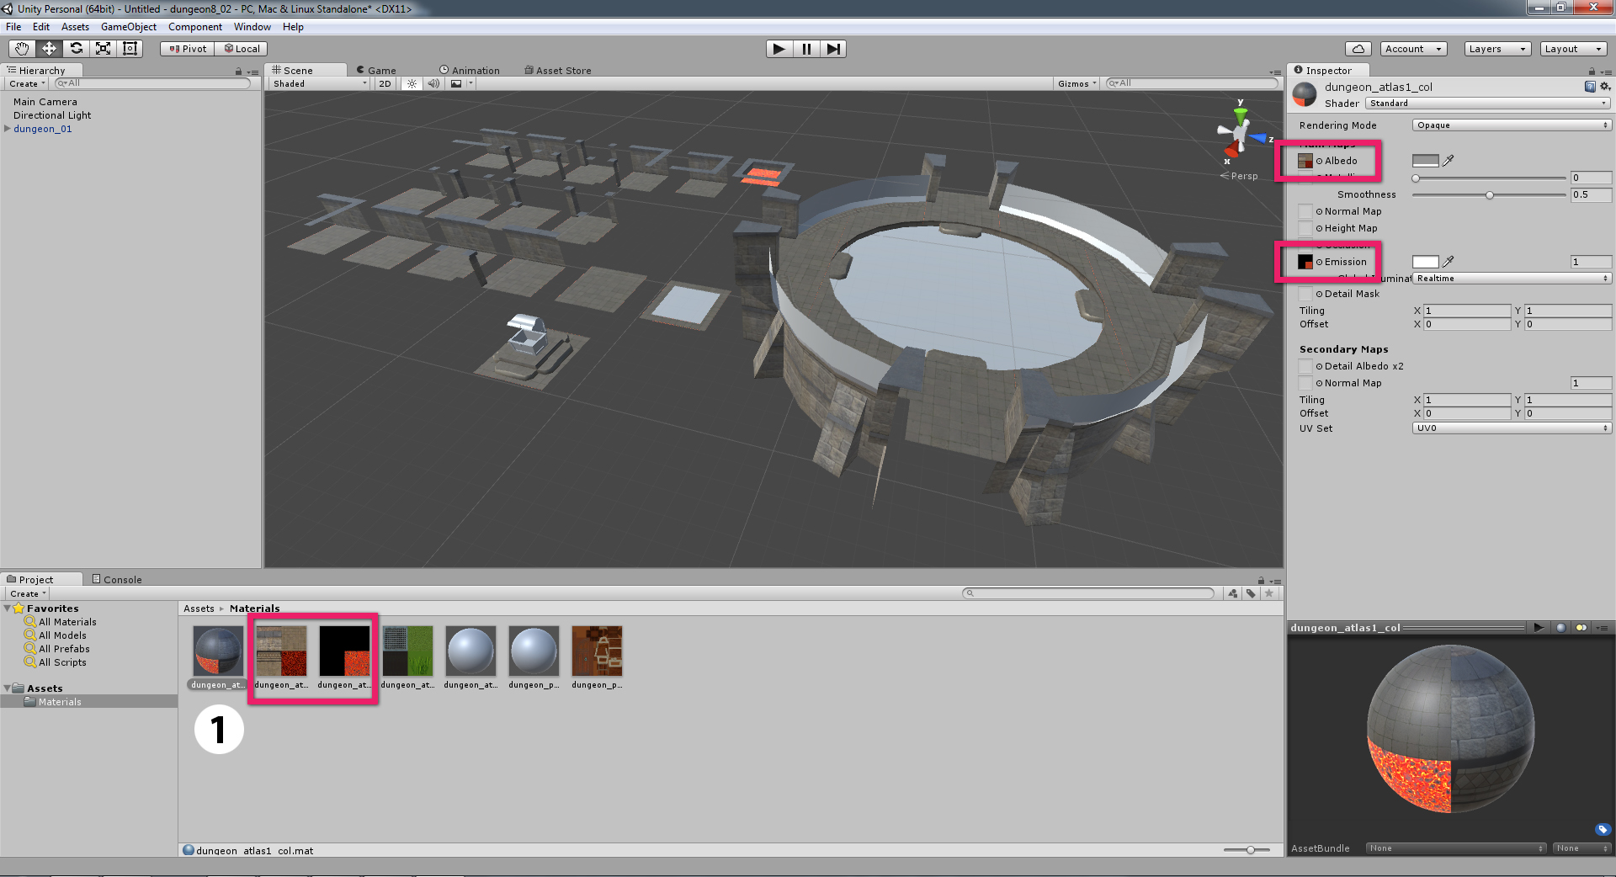
ASSEMBLING MATERIALS
Material 1: Drag the colour map to the Albedo slot. Drag the coloured emission map to the Emission slot.

Slide 13
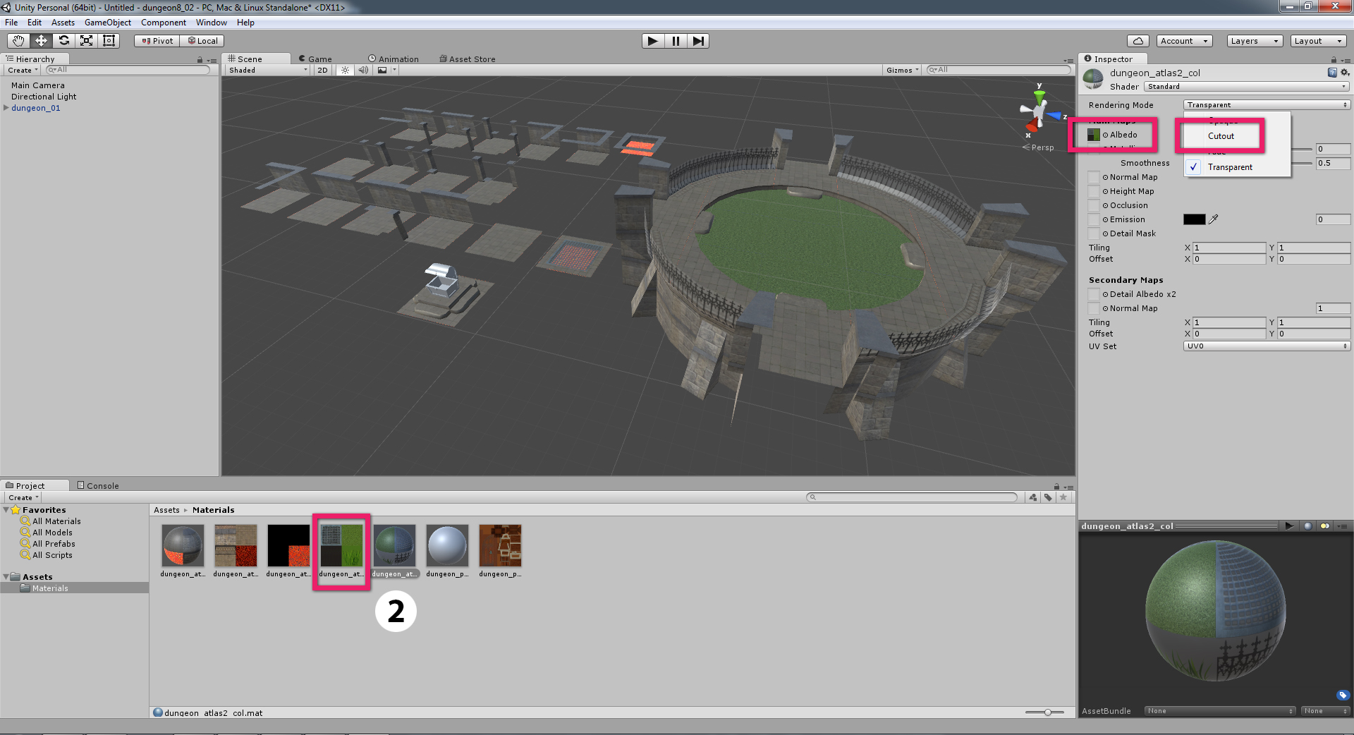
ASSEMBLING MATERIALS
Material 2: Drag the colour map (with opacity) to the Albedo slot. Change the Rendering Mode to Cutout.

Slide 14

ASSEMBLING MATERIALS

Slide 15
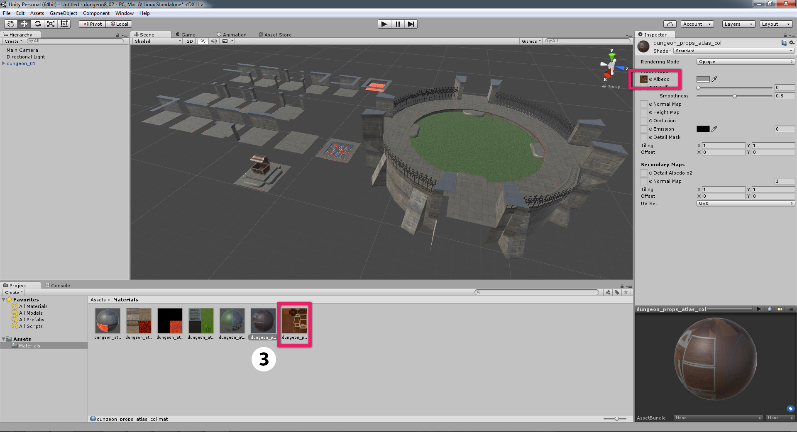
ASSEMBLING MATERIALS
Material 3: Drag the colour map to the Albedo slot. For opacity or emission, follow previous steps.

Slide 16
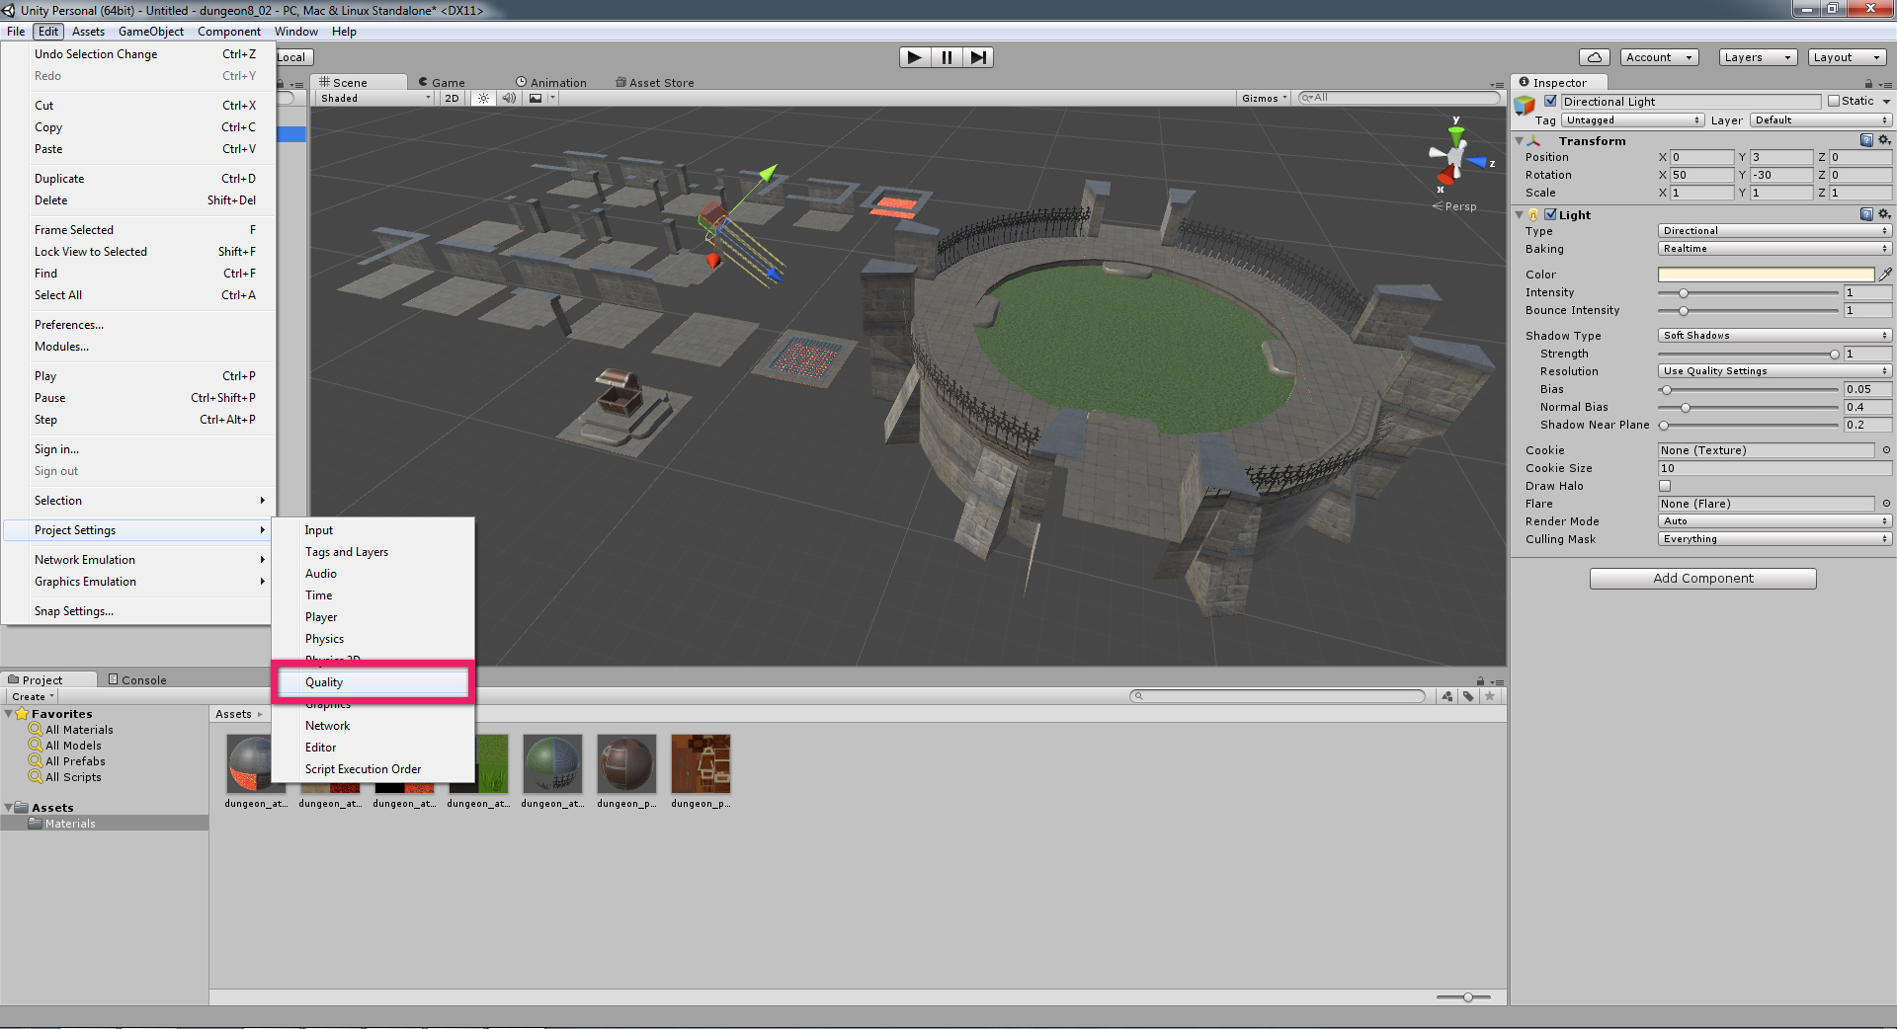
LIGHTING AND SHADOWS
Add a directional light. This might be your key light, or you might want to use it to test your shadows and can delete it later. If shadows are not showing, or are fading when zooming in and out of the scene, open the Quality dialogue box.

Slide 17
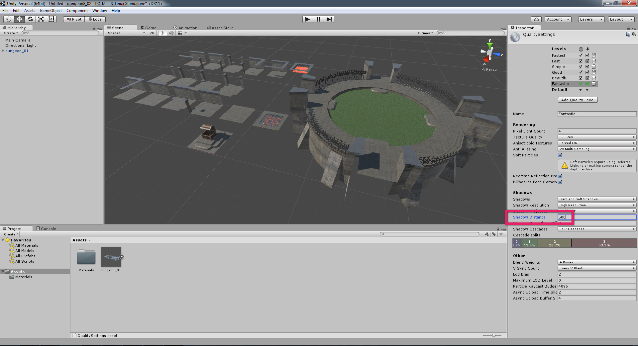
LIGHTING AND SHADOWS
Amend the Shadow Distance value until the shadows behave as expected.

Slide 18
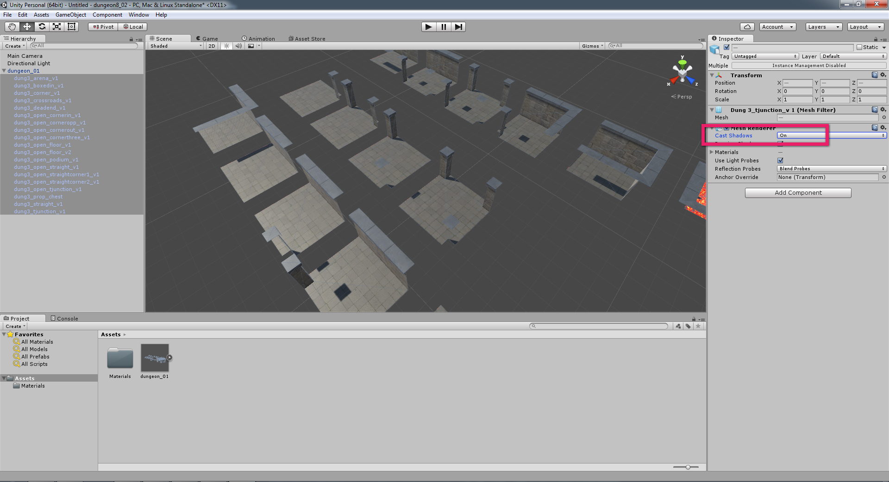
LIGHTING AND SHADOWS
Single-sided polys do not respond well to lights. As such, all child meshes need to be selected in the Hierarchy panel. In the Inspector, change Cast Shadows from On to Two Sided.

Slide 19
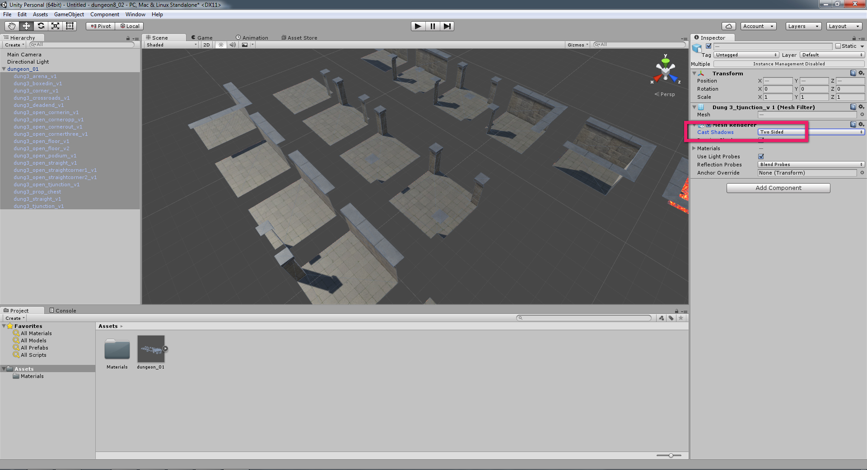
LIGHTING AND SHADOWS

Slide 20
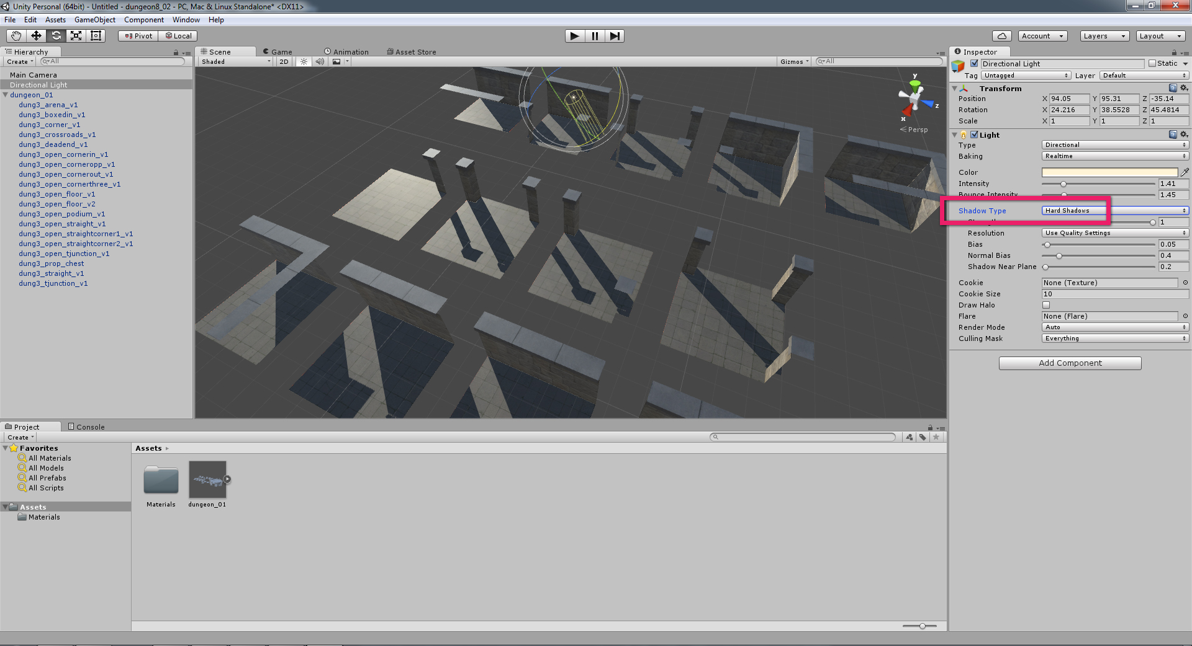
LIGHTING AND SHADOWS
With a light selected, hard or soft shadows can be cast by amending the Shadow Type property.

Slide 21
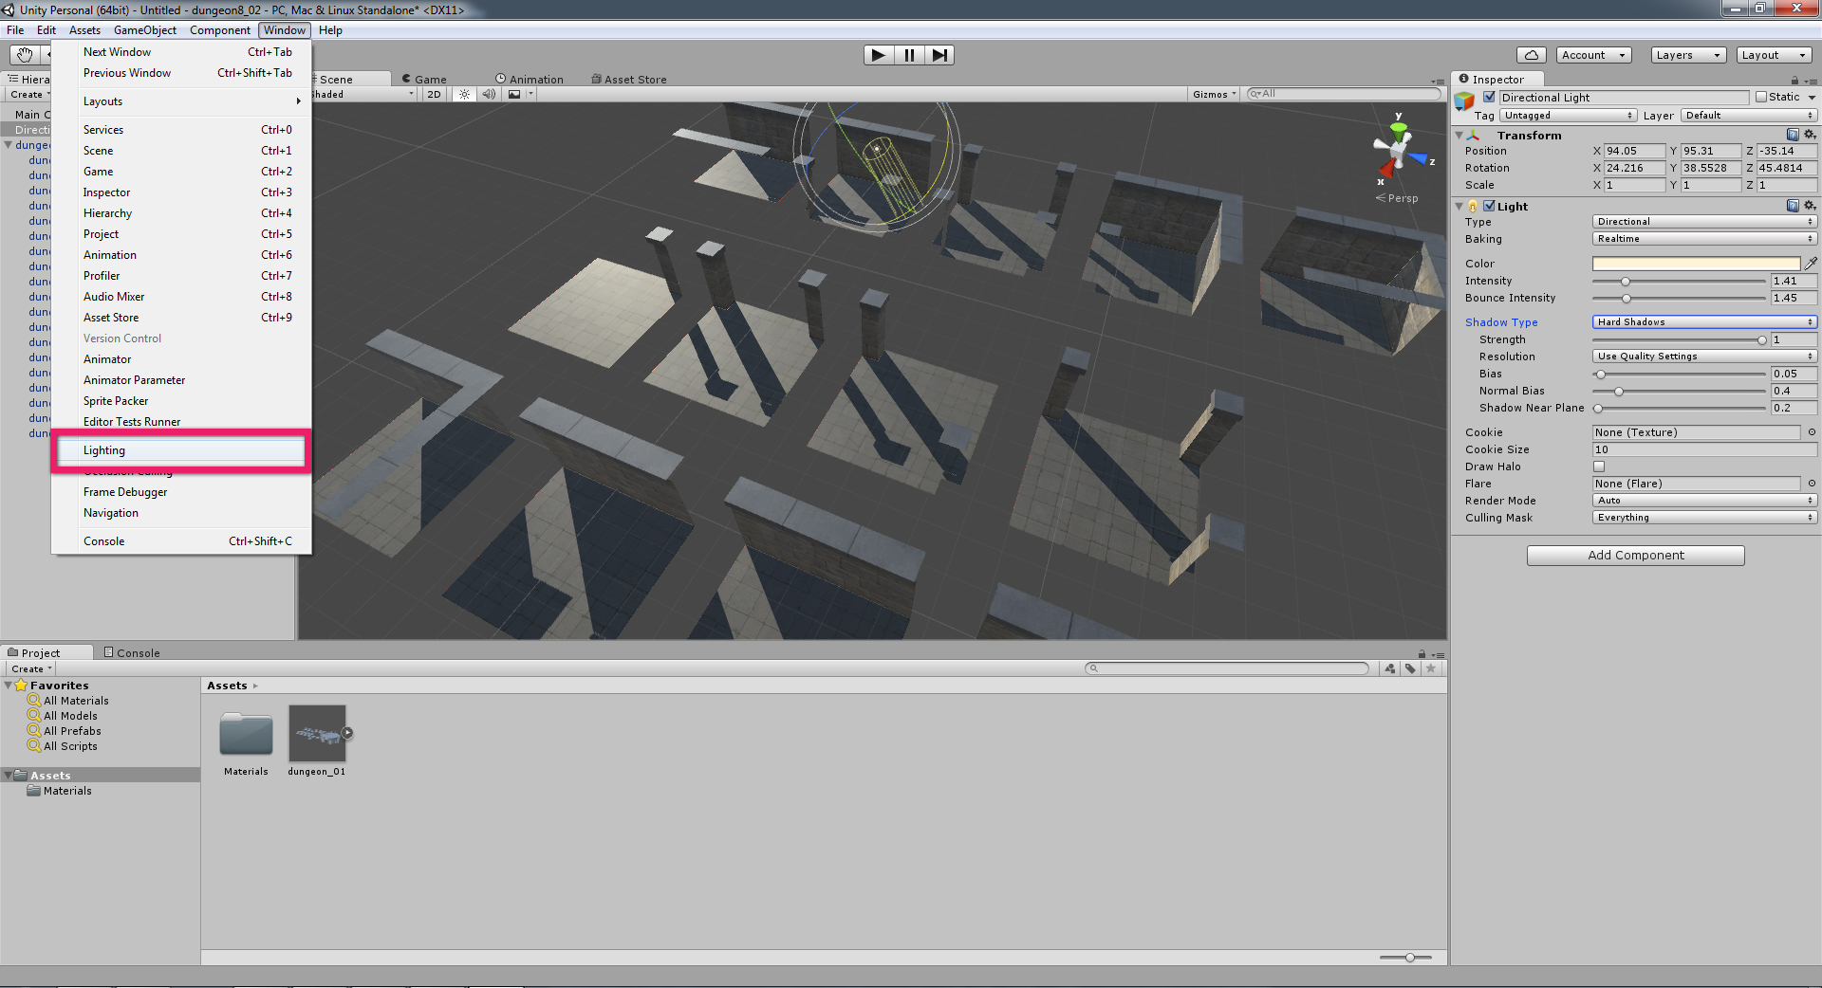
LIGHTING AND SHADOWS
By default, a skybox bounces light around the scene. To address this, navigate to the Lighting panel.

Slide 22
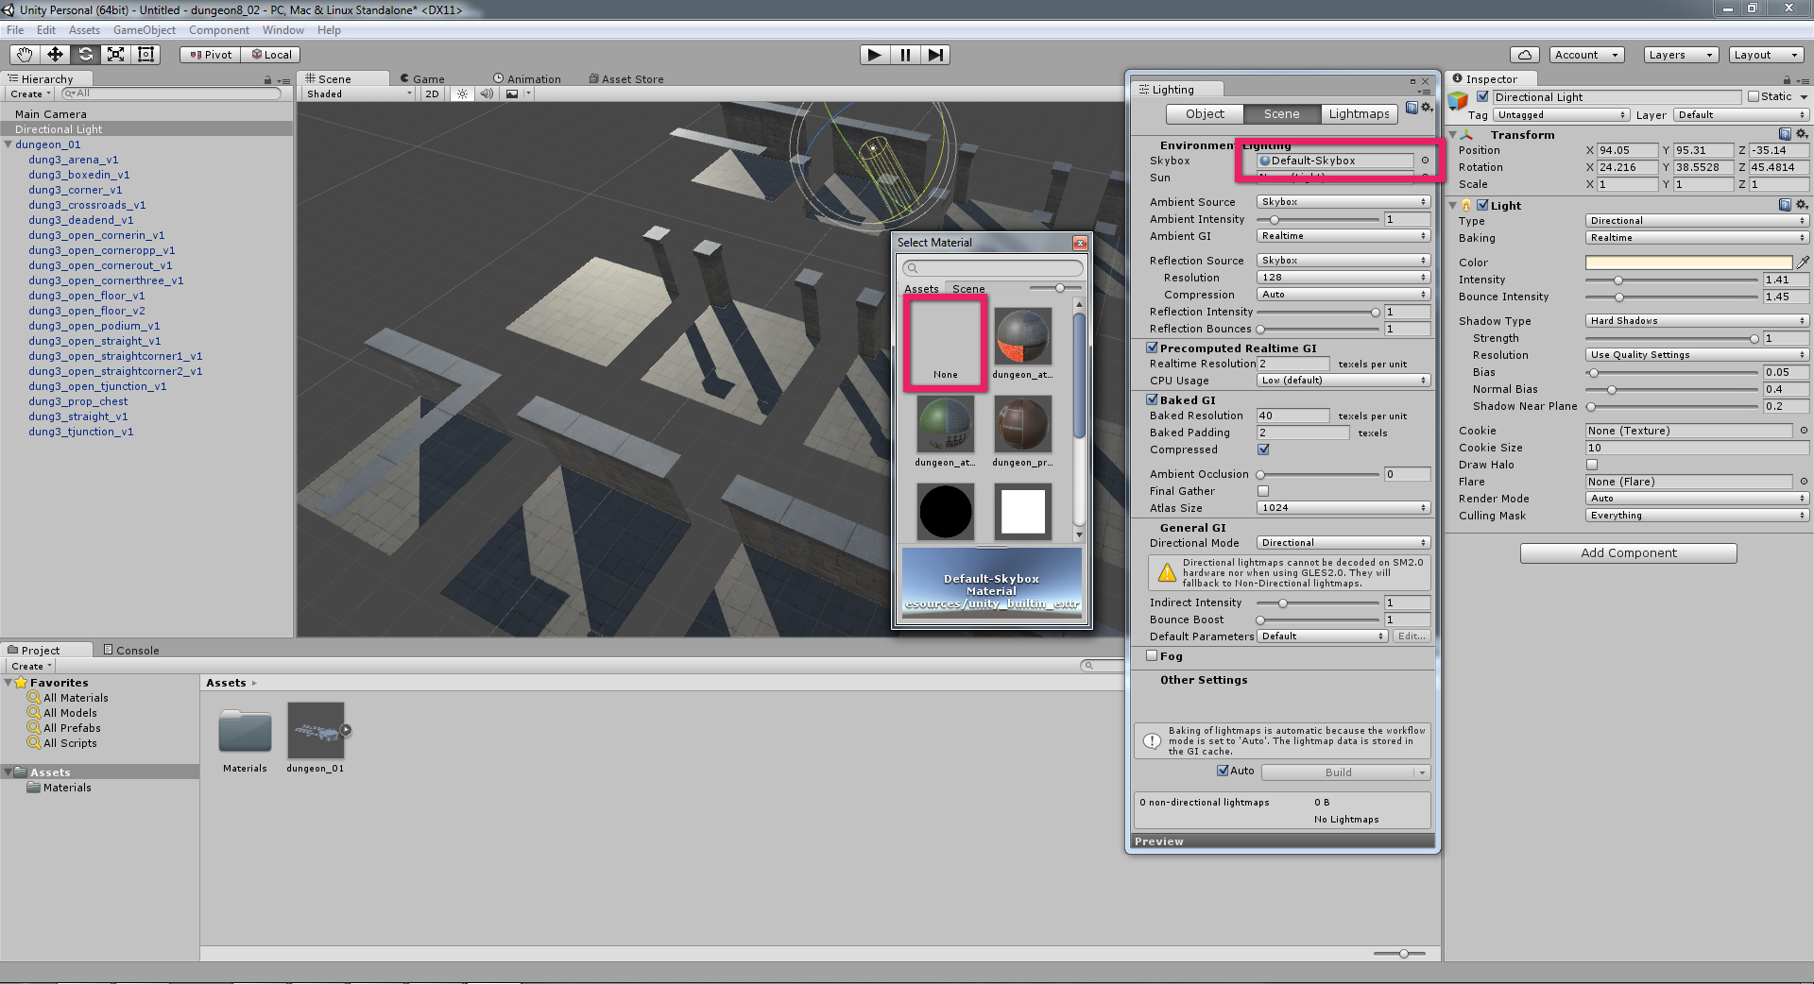
LIGHTING AND SHADOWS
Under the Scene tab, click on the skybox option and change to None.

Slide 23
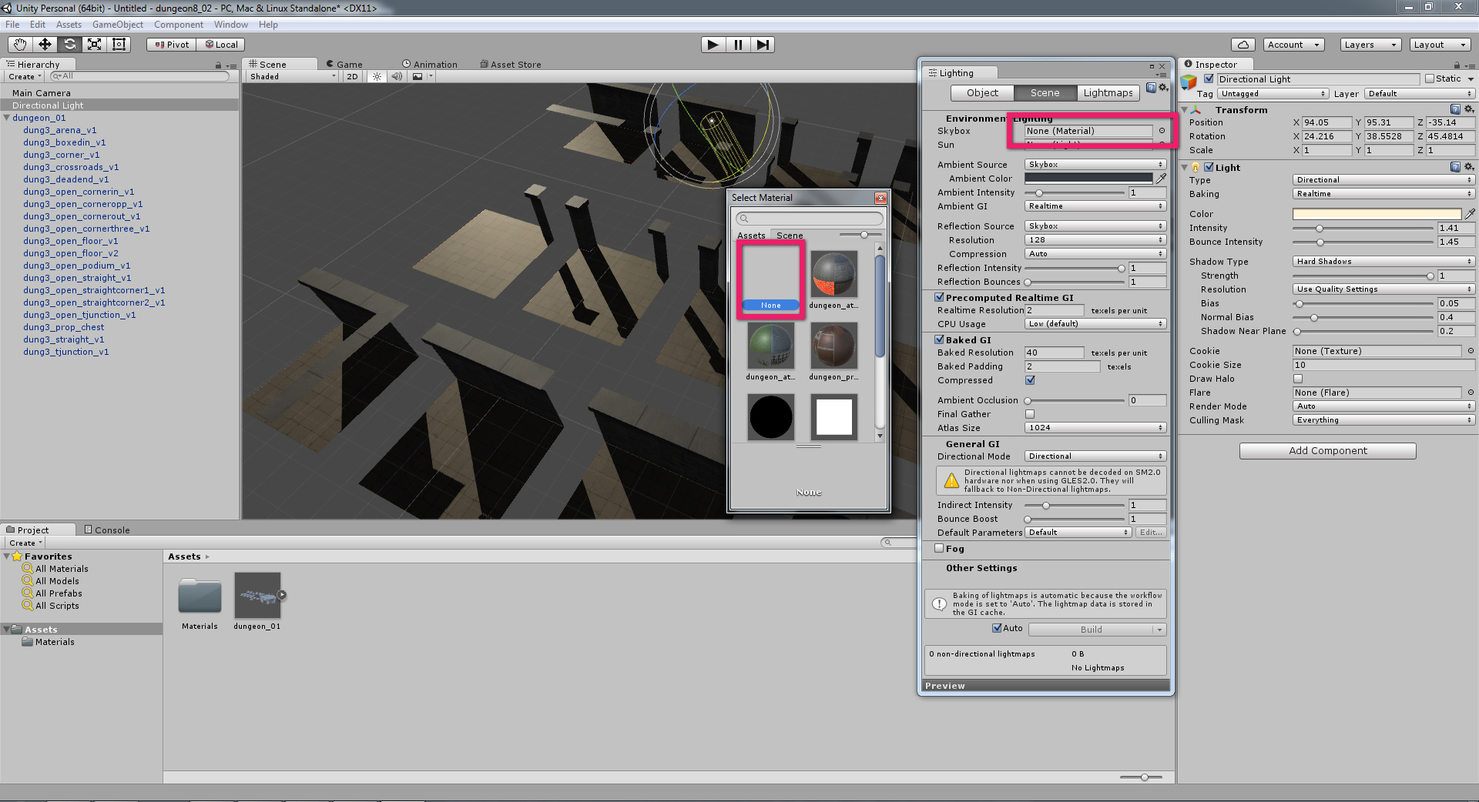
LIGHTING AND SHADOWS
You may now control all lighting and shadow properties using your scene lights.

Slide 24
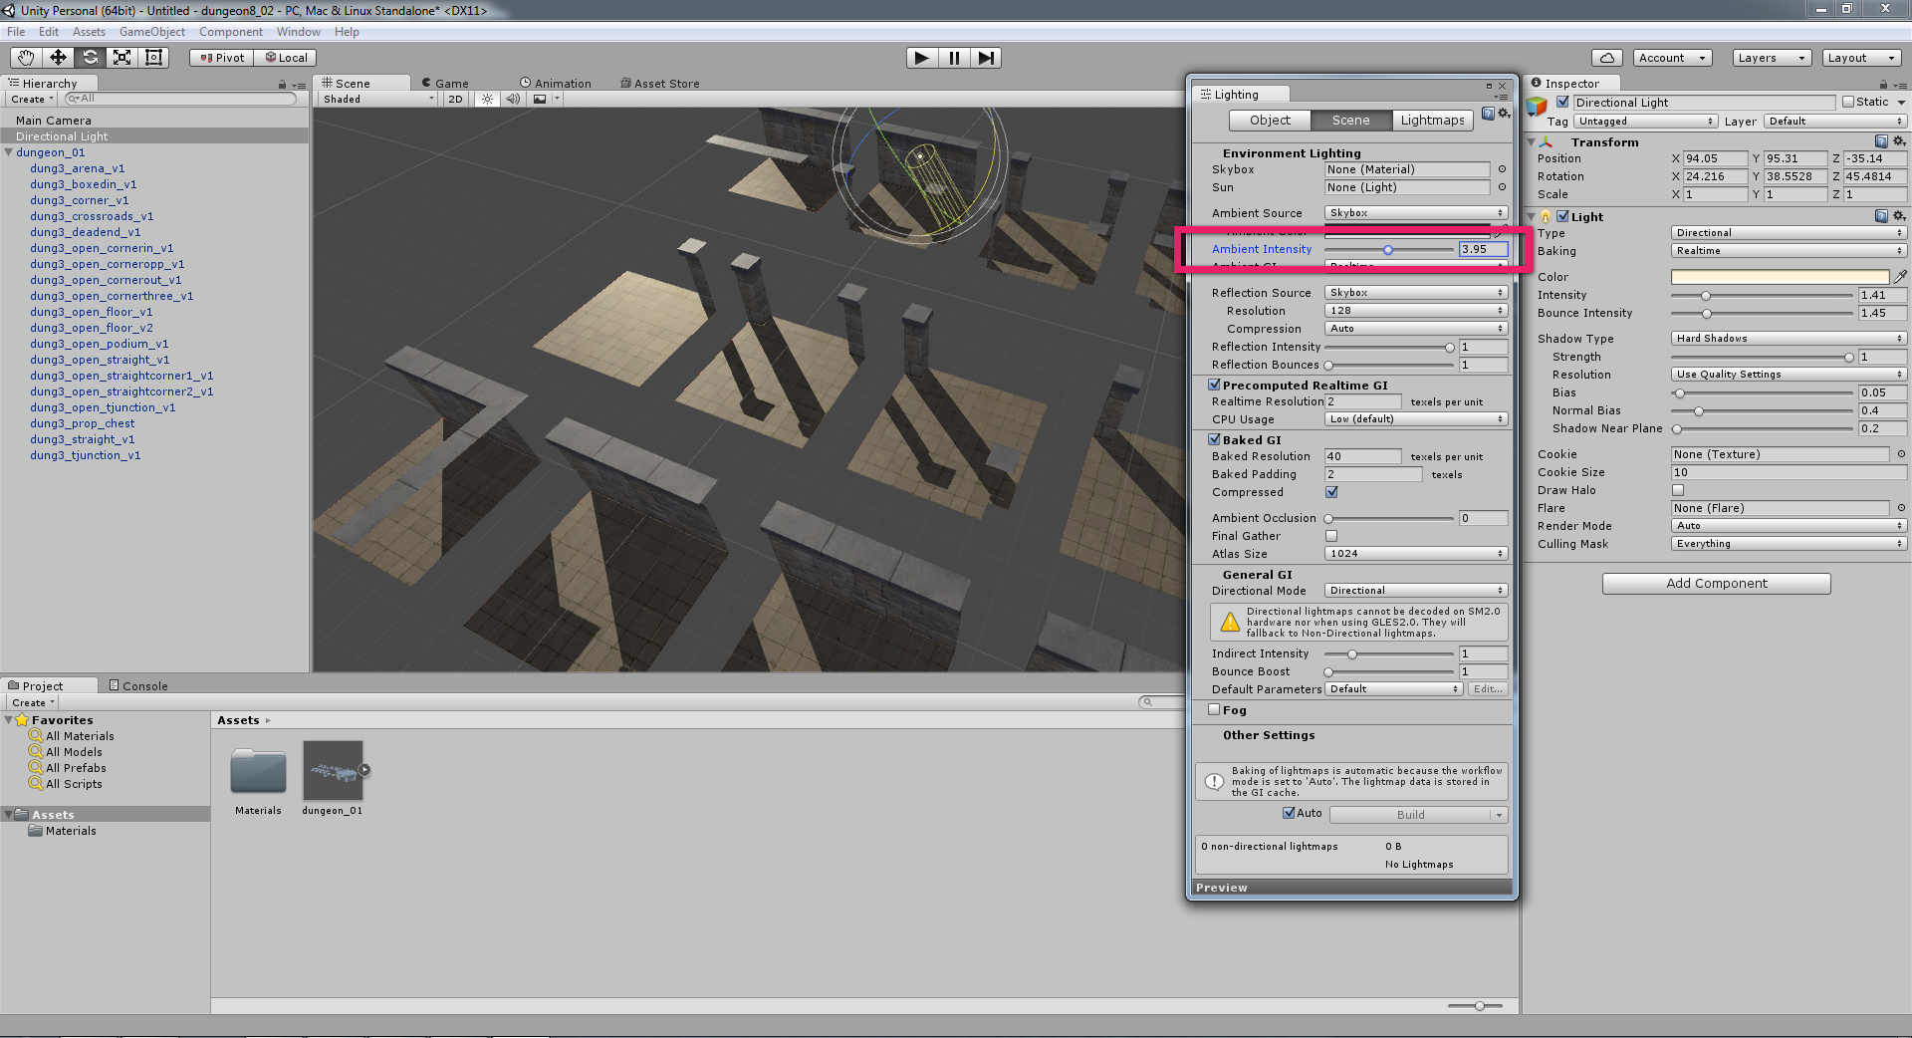
LIGHTING AND SHADOWS
Bounced light is now controllable using the Ambient Intensity slider.

Slide 25
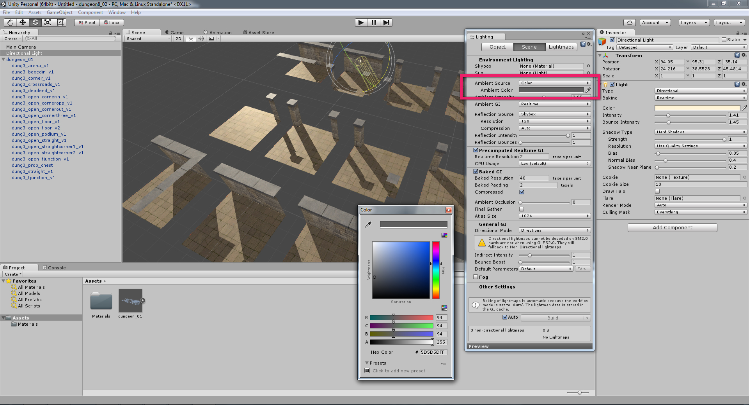
LIGHTING AND SHADOWS
Shadow colours are controllable by setting the Ambient Source to Colour and then amending the Ambient Colour.

Slide 26
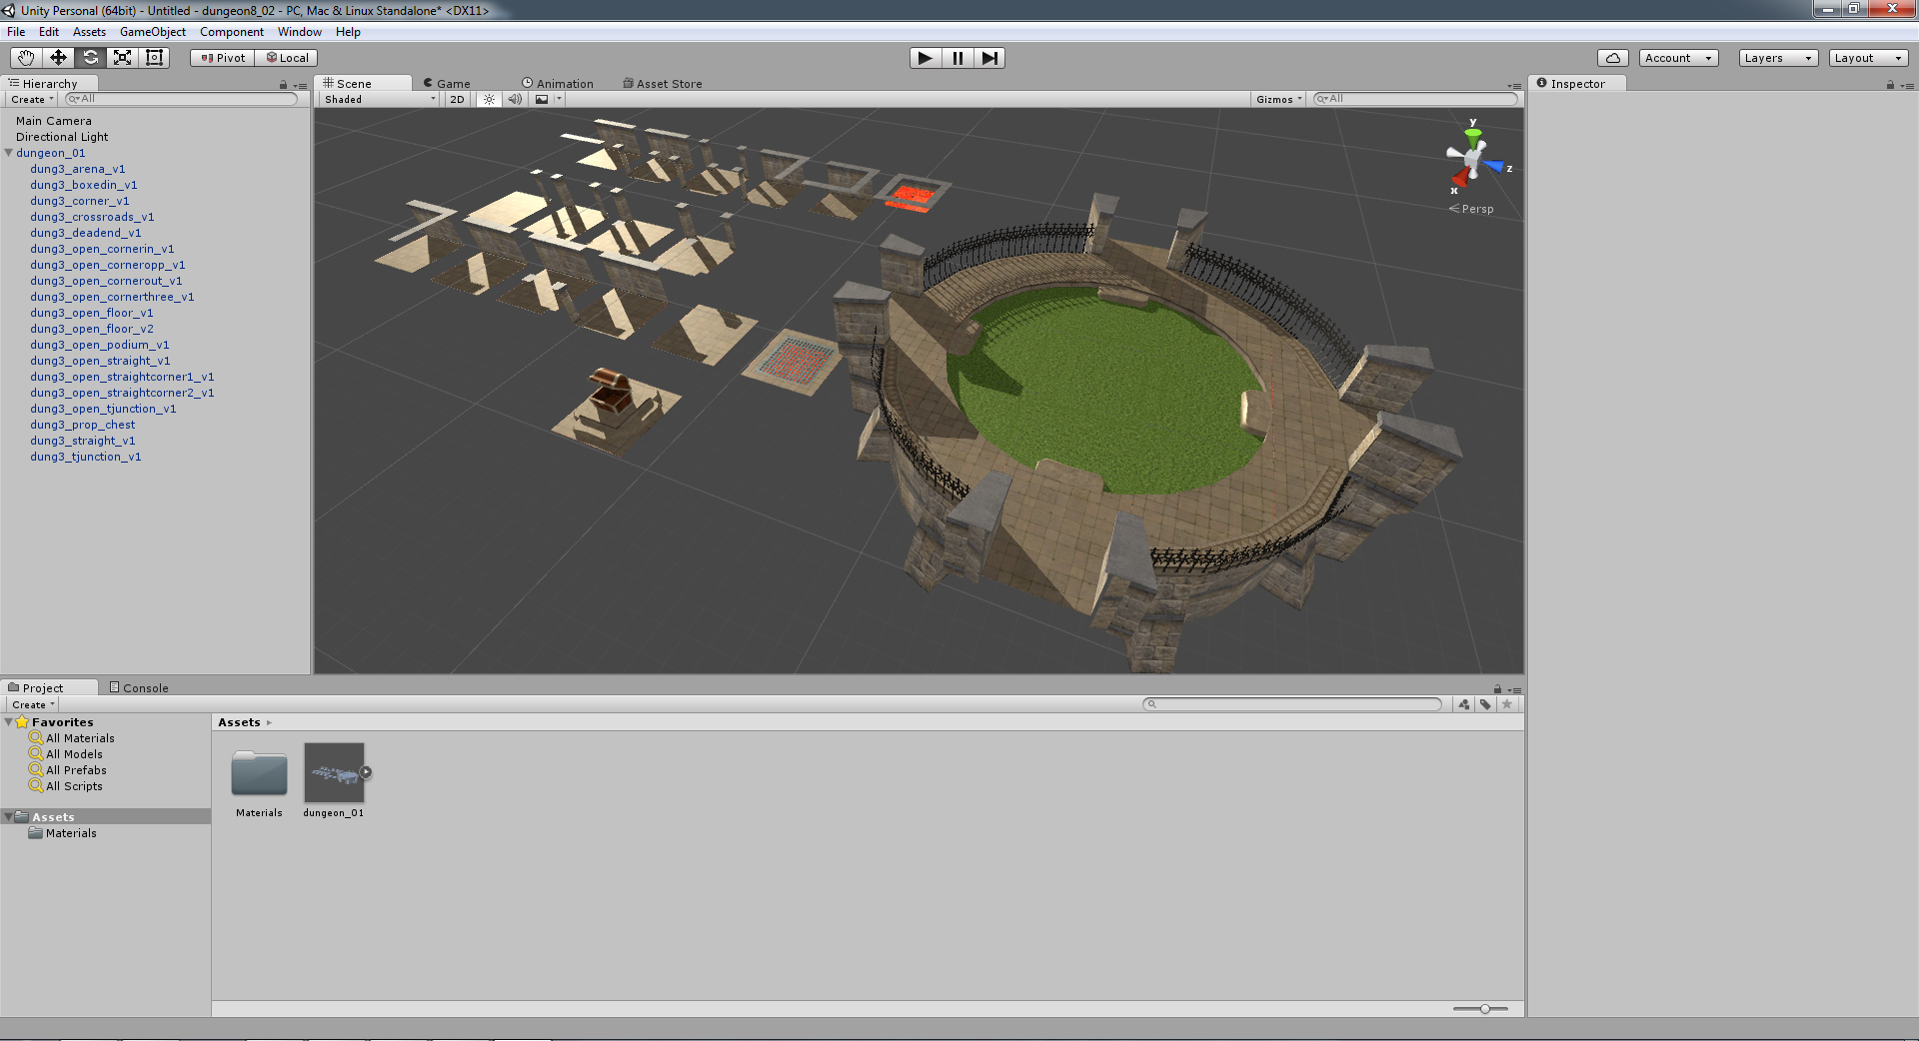
LIGHTING AND SHADOWS

Slide 27
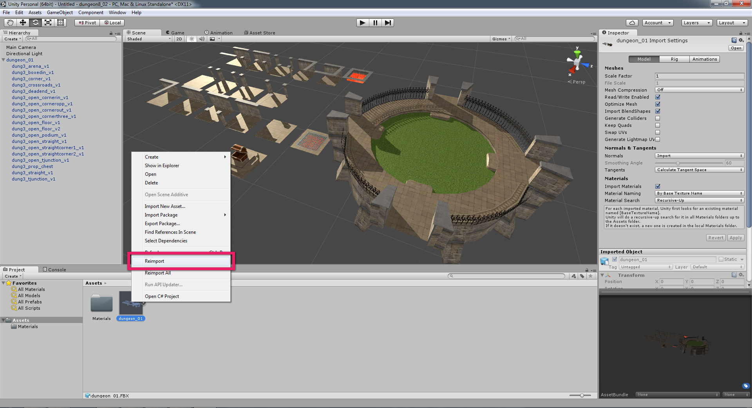
3DS MAX ADJUSTMENTS
If you need to tweak anything in 3DS Max, you can then update the Unity scene by right-clicking on the parent asset (in the Project Assets panel) and selecting Reimport.

Slide 28
ASSEMBLING TILES IN UNITY
1) To select a tile in the scene, double-click the tile. (The first click selects the parent, i.e. the entire suite of tiles; the second click selects the specific child, i.e. the tile.)
2) Keep the imported suite of tiles together and build your scene from duplicates of these tiles.
Once a tile has been selected, press CTRL + d to duplicate the tile.
3) Snap tiles together by holding v when translating.
4) Accurately rotate tiles by typing in transform values.
5) Add point lights to the scene as you go. You may add as many point lights as you require. You can duplicate and snap these just as you would geometry.

